Slide 1


Multi-Vendor Web Application
This presentation covers a Multi-Vendor Web Application project developed in ASP.NET Core Web API using SQLite Server, detailing its architecture, technologies, features, and future enhancements.

Slide 2

Introduction to Multi-Vendor App
The Multi-Vendor App is designed to create a seamless marketplace experience for users, where they can access a variety of products from multiple vendors in one unified platform. The main objective is to facilitate broader vendor reach while enhancing user options.
Overview of the Multi-Vendor App
A platform where multiple vendors can list their products.
Purpose and Goals
Create a user-friendly marketplace for diverse product selection.

Slide 3


Technology Stack Overview
1
ASP.NET Core
A cross-platform framework for building cloud-based applications, known for its speed and security.
2
SQLite
A lightweight database system used for data storage, ideal for small to medium-sized applications.
3
Entity Framework
An Object-Relational Mapping (ORM) tool that simplifies database interactions by using C# objects.

Slide 4


System Architecture
Architecture Overview
Data Flow
The architecture is built on a three-tier model comprising the database (SQLite), a backend API (ASP.NET Core Web API), and the frontend (user interface).
Client requests are processed by the API, which communicates with the database to retrieve or store data, ensuring a seamless user experience.
1
2

Slide 5
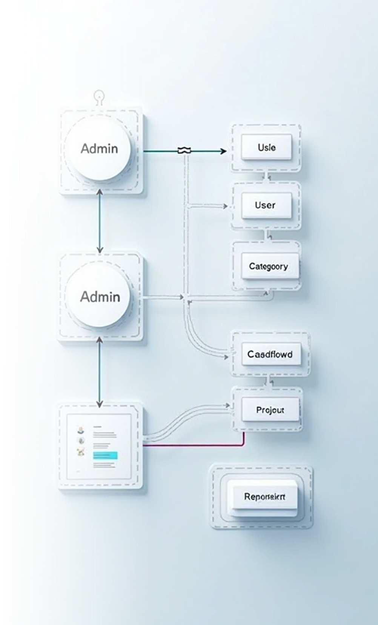

Database Design
Tables Overview
Relationships
ER Diagram
Admins manage users and categories, while users can create product listings linked to specific categories.
A visual representation detailing how tables interconnect, illustrating data flow within the database.
The main tables include Admin, User, Category, and Product, each designed to hold related data efficiently.

Slide 6



Marketplace Features
User Features
2
Users can register, log in, post products, and browse products by category, creating an interactive shopping experience.
Admin Features
Administrators can manage user accounts, oversee product categories, and maintain the overall integrity of the marketplace.
1
Notifications
3
Users receive updates regarding their product postings and interactions, enhancing engagement.

Slide 7

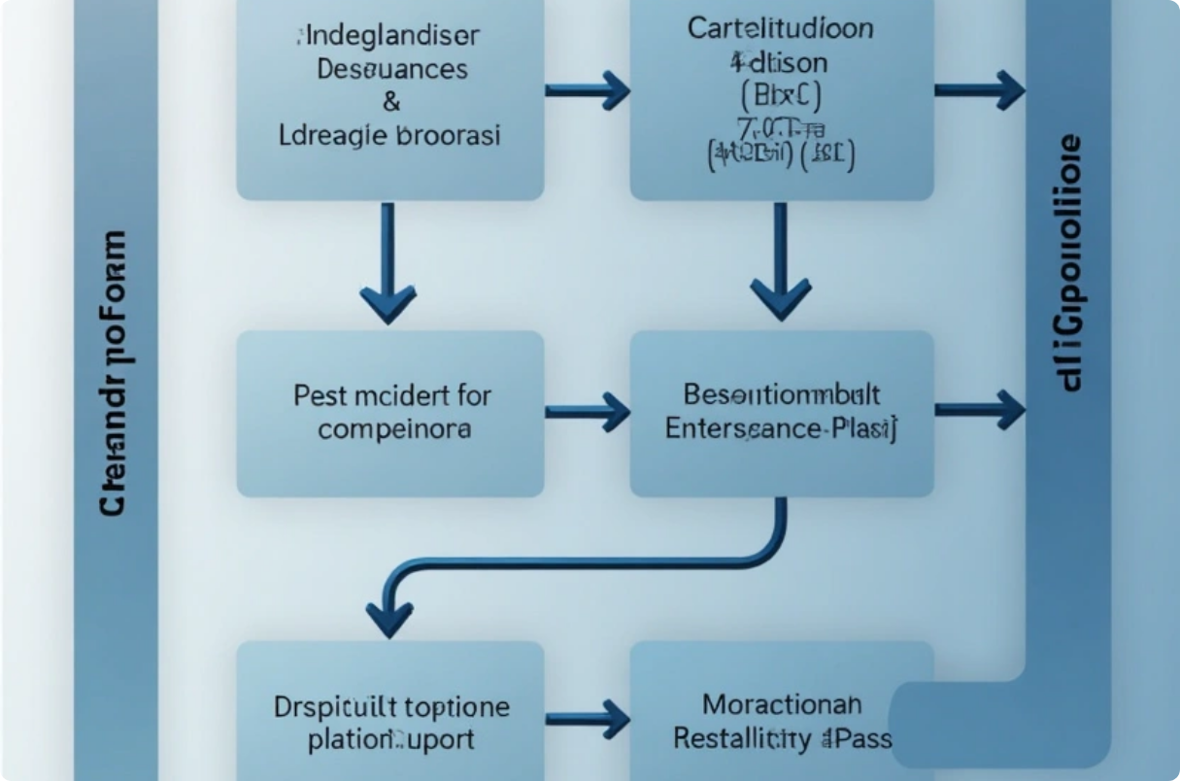

API Design
This section provides an overview of API design, focusing on RESTful API principles, including a comprehensive suite of endpoints and sample API calls demonstrating interactions with user data and product listings.
RESTful API Overview
Sample API Calls
A comprehensive suite of RESTful endpoints allows for actions such as creating, reading, updating, and deleting resources.
Showcasing examples of GET and POST requests that demonstrate interactions with user data and product listings for better understanding.

Slide 8



User Interface (UI) Design
Screenshots
2
Visual elements from the application help illustrate the user interface, displaying critical functionalities and layout designs.
Key UI Pages
The application includes a Home page for browsing, an Admin Dashboard for management tasks, and a User Dashboard displaying personal data.
1
Responsive Design
3
The UI is designed to be mobile-friendly, ensuring accessibility across a range of devices.

Slide 9



Implementation Details
Models
Controllers
Views
Definitions of data structures used in the application.
Backend logic controlling the flow of data and handling requests.
HTML and Razor pages designed for dynamic data rendering.

Slide 10




Challenges and Solutions
Data Validation
Handling Concurrent Users
Establishing thorough validation checks both on the client and server sides to ensure data integrity and prevent errors.
Security Concerns
Implementing locking mechanisms in the database to manage concurrent data changes by multiple users effectively.
Addressing potential security vulnerabilities through authentication and authorization measures, safeguarding user data.
2
1
3

Slide 11




Future Enhancements
2
Mobile Application
Developing a complementary mobile application to extend the platform’s reach and enhance user accessibility.
Additional Payment Options
1
Integrating more payment gateways to provide users with broader transaction choices.
Advanced Search Features
Implementing AI-based search algorithms to improve product discoverability, offering personalized suggestions to users.
3

Slide 12

Conclusion of Multi-Vendor Web Application
Summary
The Multi-Vendor Web Application serves as a comprehensive solution for facilitating e-commerce transactions between users and vendors, built on a robust technology stack.
Final Thoughts
Continuous development and user feedback will guide future enhancements, ensuring the platform meets evolving market demands.

Slide 13

Thank You…

